Slide 1
Web Design
Final Exam Review

Slide 2
Get a partner…
Take turns answering questions; the correct answer will appear when you click. Good luck!

Slide 3
Question:
The default horizontal alignment for <P> is--
left

Slide 4
Question:
Which tag is used to create a line break?
<br />

Slide 5
Question:
Which tag creates a numbered list?
<ol>

Slide 6
Question:
How many header elements (H) are available in HTML?
6
<h1> through <h6>
<h6> is the smallest

Slide 7
Question:
<strong><em>Bunnies!</strong></em>
What is wrong with the syntax (setup) on the code shown at right?
Nesting issues (tags not closed in reverse order they were opened)

Slide 8
Question:
Hi
Hello
What’s up?
What tag creates a bullet?
<li>

Slide 9
Question:
<a href=“page2.html”>
<a href=“http://www.mypage.com/page2.html”>
Which is an ABSOLUTE reference? (at right)
What is the difference between an ABSOLUTE and a RELATIVE hyperlink reference?
The bottom is “absolute” because it uses http:// meaning that regardless of where you are at, you can get to the site on the internet. A relative reference just points to file in a local folder.

Slide 10
Question:
What is the code used to insert a picture of a pig named pig.gif with a text alternative that says oink?
<img src=“pig.gif” alt=“Oink!” />

Slide 11
Question:
What code would be used to insert a standard bulleted list?
<ul>

Slide 12
Question:
What is the standard code to bold words?
What is the “old” deprecated tag for bold?
<strong>
(replaced <b>)

Slide 13
Question:
What is the standard code to italicize words?
What is the “old” deprecated tag for italics?
<em>
(replaced <i>)

Slide 14

Question:
What is the tag used to insert a horizontal line?
<hr />

Slide 15
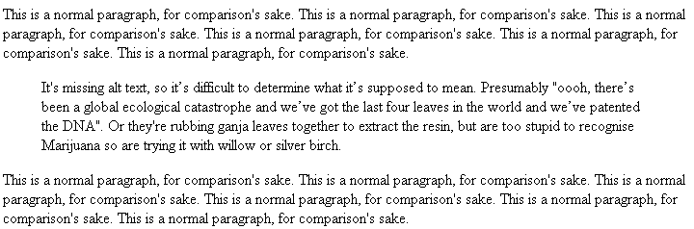
Question:
What is the tag used to insert a paragraph with indented left and right margins?
<blockquote>

Slide 16
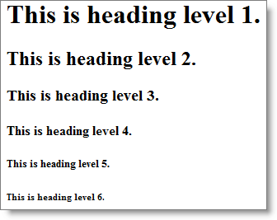
Question:
What would the size be of the text pointed to if all are headings in HTML?
<h4>

Slide 17
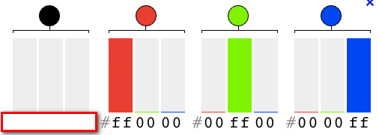
Question:
What is the hexadecimal color code for BLACK?
#000000

Slide 18
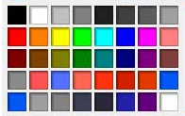
Question:
#FFFFFF represents what color?
white

Slide 19
Question:
Block OR inline element?
<p>
BLOCK

Slide 20
Question:
Block OR inline element?
<ul>
BLOCK

Slide 21
Question:
Block OR inline element?
<hr />
BLOCK

Slide 22
Question:
Block OR inline element?
<br />
INLINE

Slide 23
Question:
Block OR inline element?
<strong>
INLINE

Slide 24
Question:
Block OR inline element?
<span>
INLINE

Slide 25
Question:
Block OR inline element?
<img>
INLINE

Slide 26
Question:
Block OR inline element?
<ol>
BLOCK

Slide 27
Question:
Block OR inline element?
<em>
INLINE

Slide 28
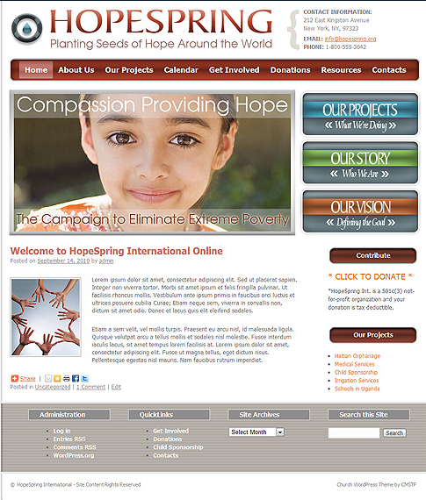
Question:
The information in the <TITLE> tag displays where?
Blue title bar or tab

Slide 29

Question:
What is the purpose of the “alt” attribute in an image?
It is used for accessibility purposes (screen readers, specifically) or if images are disabled

Slide 30
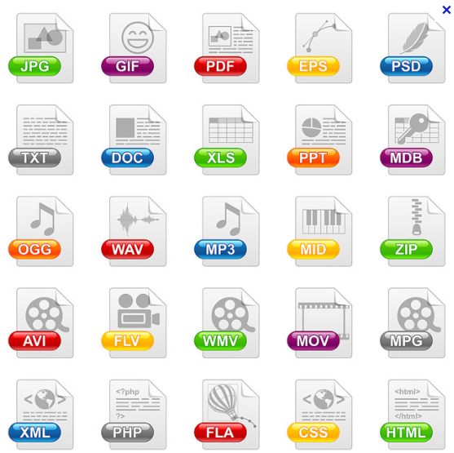
Question:
Which TWO image formats are most widely accepted on the web?
GIF and JPG (PNG are supported but are not as frequent…yet!)

Slide 31

Question:
Which image format supports both transparency and is used for animation?
GIF

Slide 32

Question:
What symbol must all hexadecimal color codes appear with?
#

Slide 33
Question:
Which CSS property is used with this value:
Verdana, Arial, sans-serif
font-family

Slide 34
Question:
Which CSS property is used with this value:
underline
text-decoration

Slide 35
Question:
Which CSS property is used with this value:
italic
font-style

Slide 36
Question:
Which CSS property is used with this value:
bold
font-weight

Slide 37
Question:
Which CSS property is used with this value:
#000000
background-color OR
color OR border-color

Slide 38
Question:
Which CSS property is used with this value:
url(background.gif)
background-image OR
list-style-image

Slide 39
Question:
Which CSS property is used with this value:
thick
border-width

Slide 40
Question:
Which CSS property is used with this value:
dotted
border-style

Slide 41
Question:
Which CSS property is used with this value:
1.6em
or random numbers…
line-height

Slide 42
Question:
Which CSS property is used with this value:
overline
Text-decoration

Slide 43
Question:
Which CSS property is used with this value:
Small, large or 10pt
Font-size

Slide 44
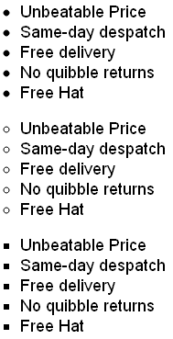
Question:
What is the default bullet type called?
disc

Slide 45
Question:
What is the hollow bullet type called?
circle

Slide 46
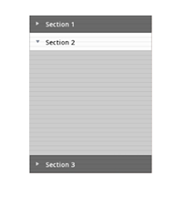
Question:
To set up the layout and structure of the website, it is most practice to utilize:
divs

Slide 47
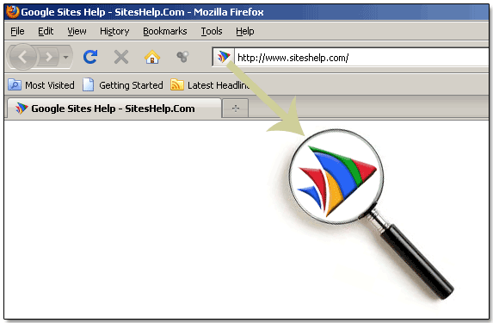
Question:
What is that fancy thing up by the URL called?
Favicon

Slide 48
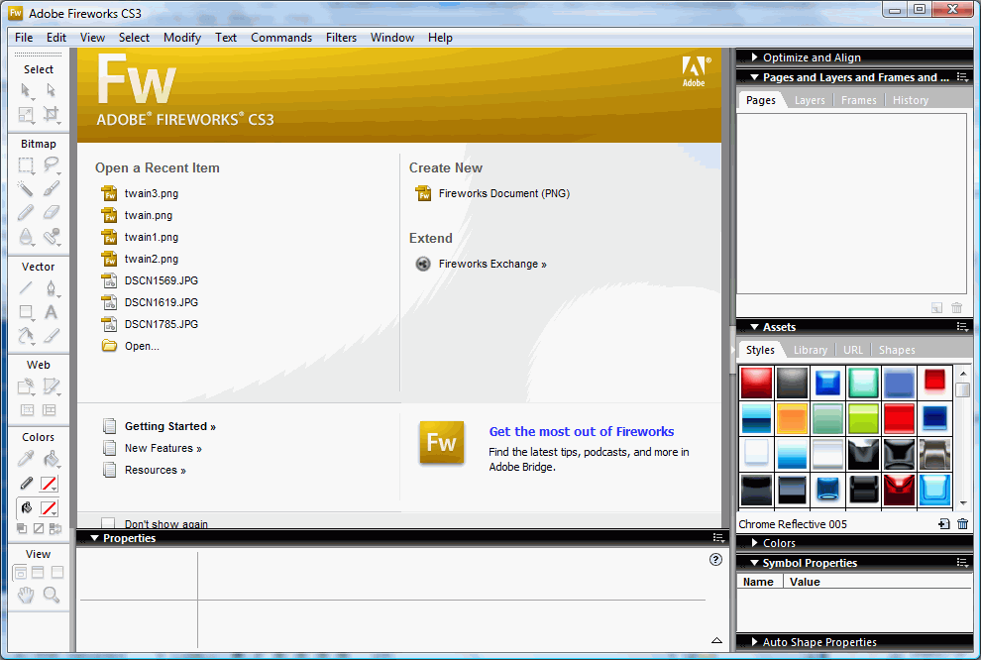
Question:
The default file format for Fireworks files that maintains both editable layers and transparency is:
PNG format

Slide 49
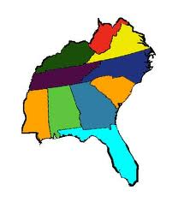
Question:
If this graphic was used on a webpage and each US state was clickable and would take you to a different website, what graphic feature would it be?
imagemap

Slide 50
Question:
What does this button adjust in Fireworks?
looping

Slide 51

Question:
An animated GIF is an image with more than one:
State/frame

Slide 52
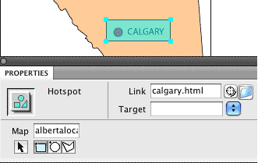
Question:
What graphic feature is this user creating in Dreamweaver?
imagemap

Slide 53

Question:
What Fireworks fill is used on this graphic?
gradient

Slide 54

Question:
What Fireworks filter is used on this text?
Drop shadow

Slide 55

Question:
What Fireworks filter is used on this text to give it a 3D raised appearance?
Bevel

Slide 56
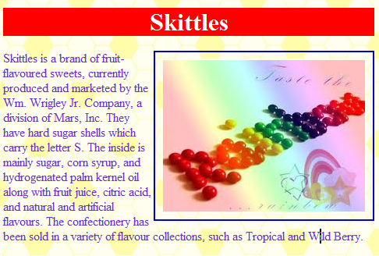
Question:
Why does the hyperlinked image have a blue border around it?
Hyperlinked images have a border unless styled for a border of none.

Slide 57
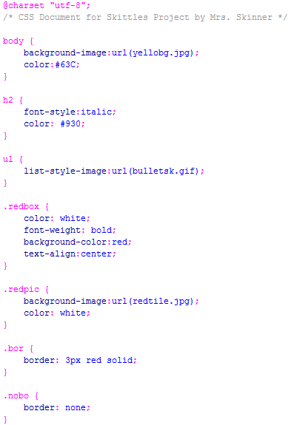
Question:
For the .bor class that is created in this document, how would an image using this class appear?
With a red border around it

Slide 58
Question:
If you inserted a bulleted list on the webpage connected to this CSS page, what kind of bullets would display?
Picture bullets of some sort

Slide 59
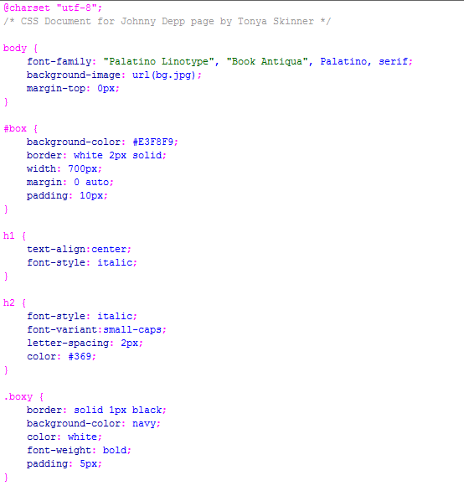
Question:
What color is the basic text for the document, provided it is not in a special DIV or class?
Black (look in body); not set and black is default

Slide 60
Question:
If someone is viewing this webpage and doesn’t have Palatino Linotype font, what font will it display in, provided it is on his computer?
Book Antiqua

Slide 61
Question:
Based on the CSS, what color will hyperlinks that have not been clicked on display as?
Blue (default, not set)

Slide 62
Question:
In the CSS, a number sign (#) in front of a selector denotes creation of a:
DIV

Slide 63
Question:
In the CSS, a period (.) in front of a selector denotes creation of a:
CLASS

Slide 64
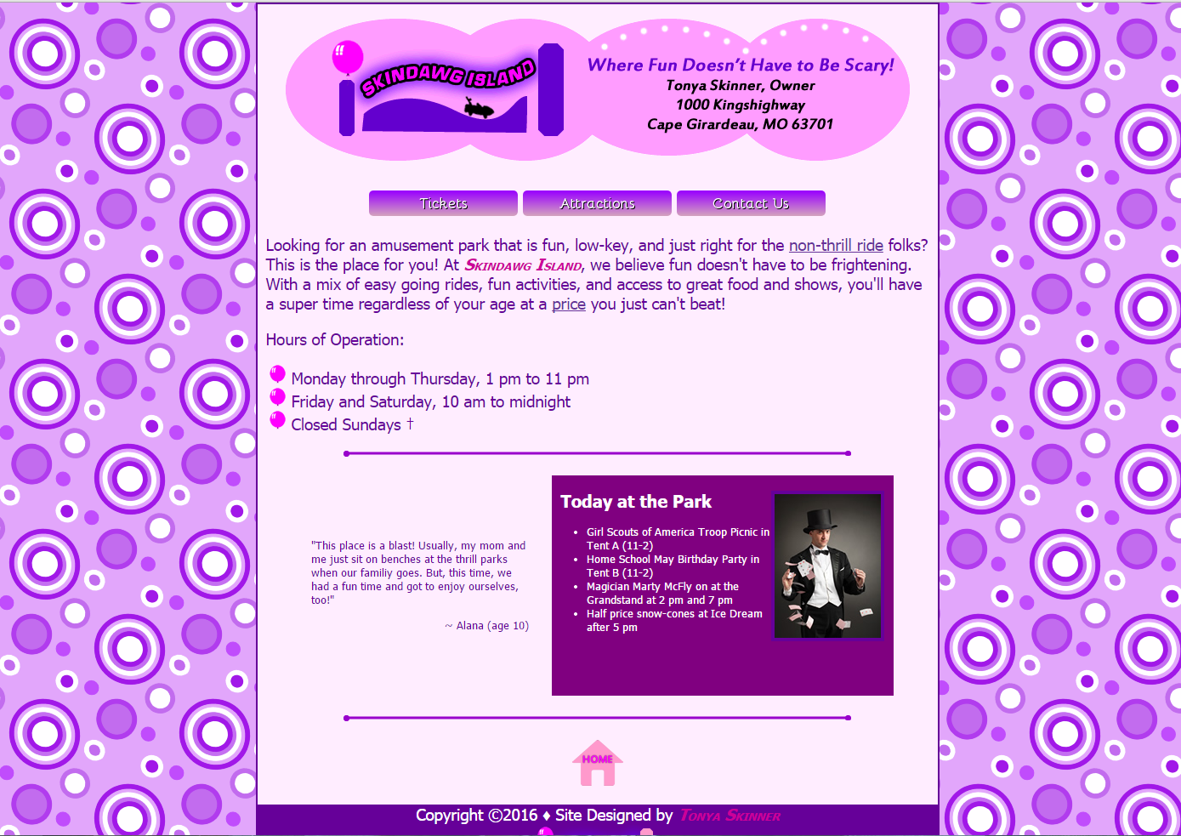
Question:
What is the CSS rule used to center a DIV on the page?
Margin: 0 auto;

Slide 65
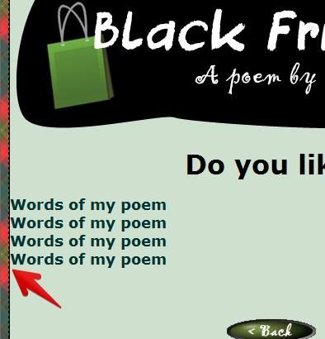
Question:
What should be modified to this h3 to get the words to stop touching the border?
Padding-left

Slide 66
Question:
GIF images, typically used or line art, can contain up to this many colors:
256

Slide 67
Question:
JPG images, typically used or photographs, can contain up to this many colors:
16 million

